Slide 1
Operating System(LAB)
Name : Fahad Ullah
Reg No : 2180209
Section : BSSE-4A
Submitted to : Sir.Sheikh Badar

Slide 2
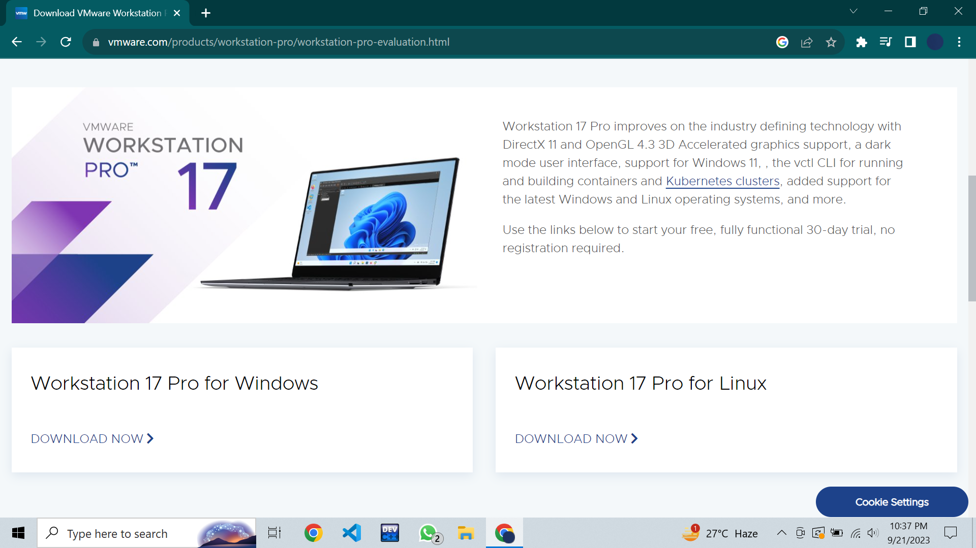
VM Workstation
First of all open google chrome,
Then Search for VM workstation.
Then click on Download Now if you want to download it for windows then click on Windows version and if you want it for Linux then click on Linux version.

Slide 3
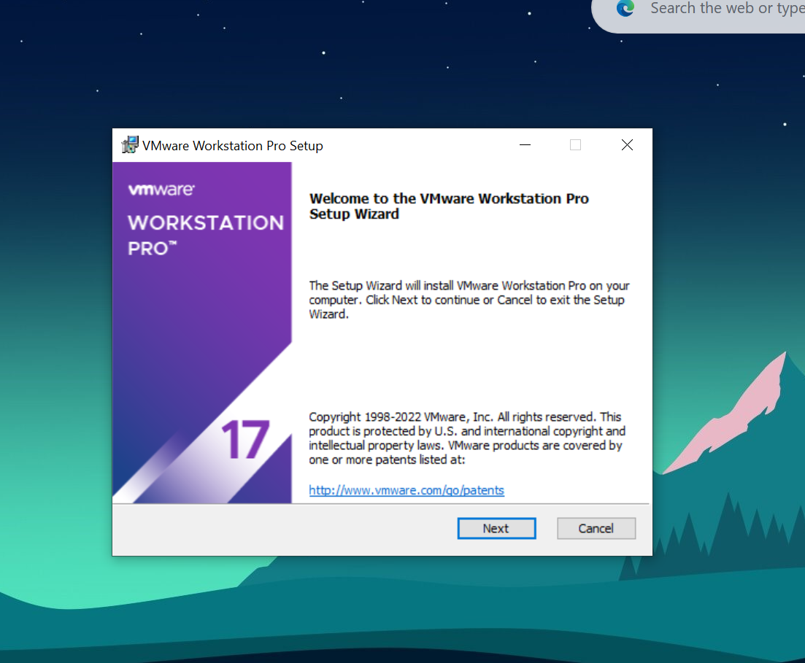
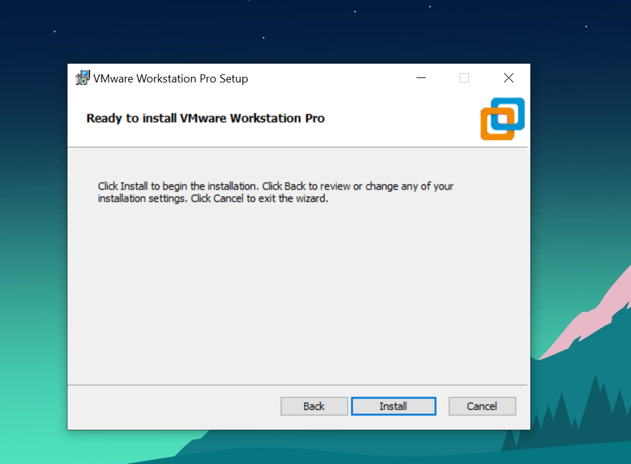
Installing VM workstation

Slide 4
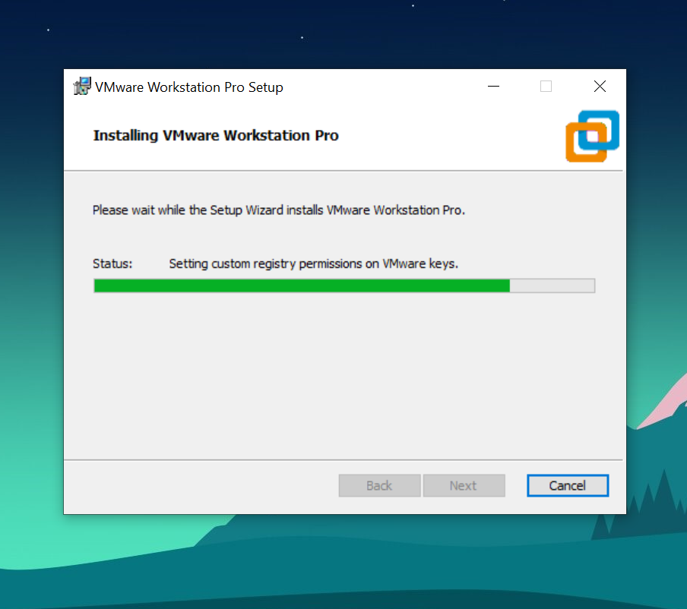
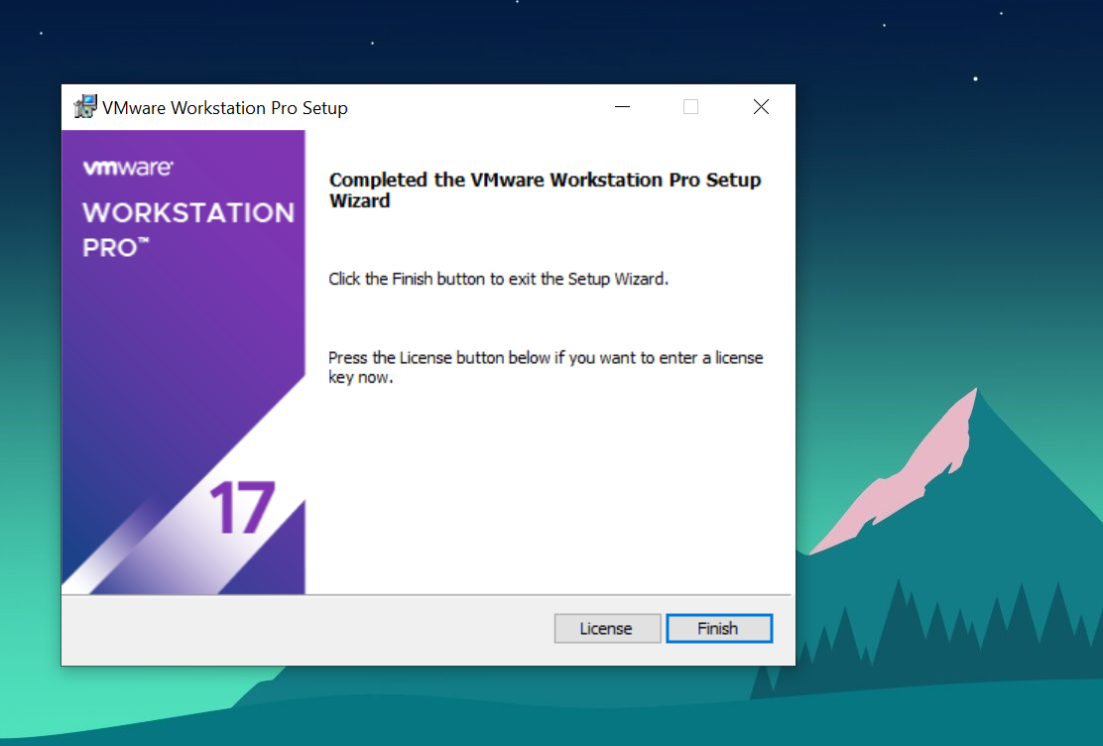
Installed Successfully

Slide 5
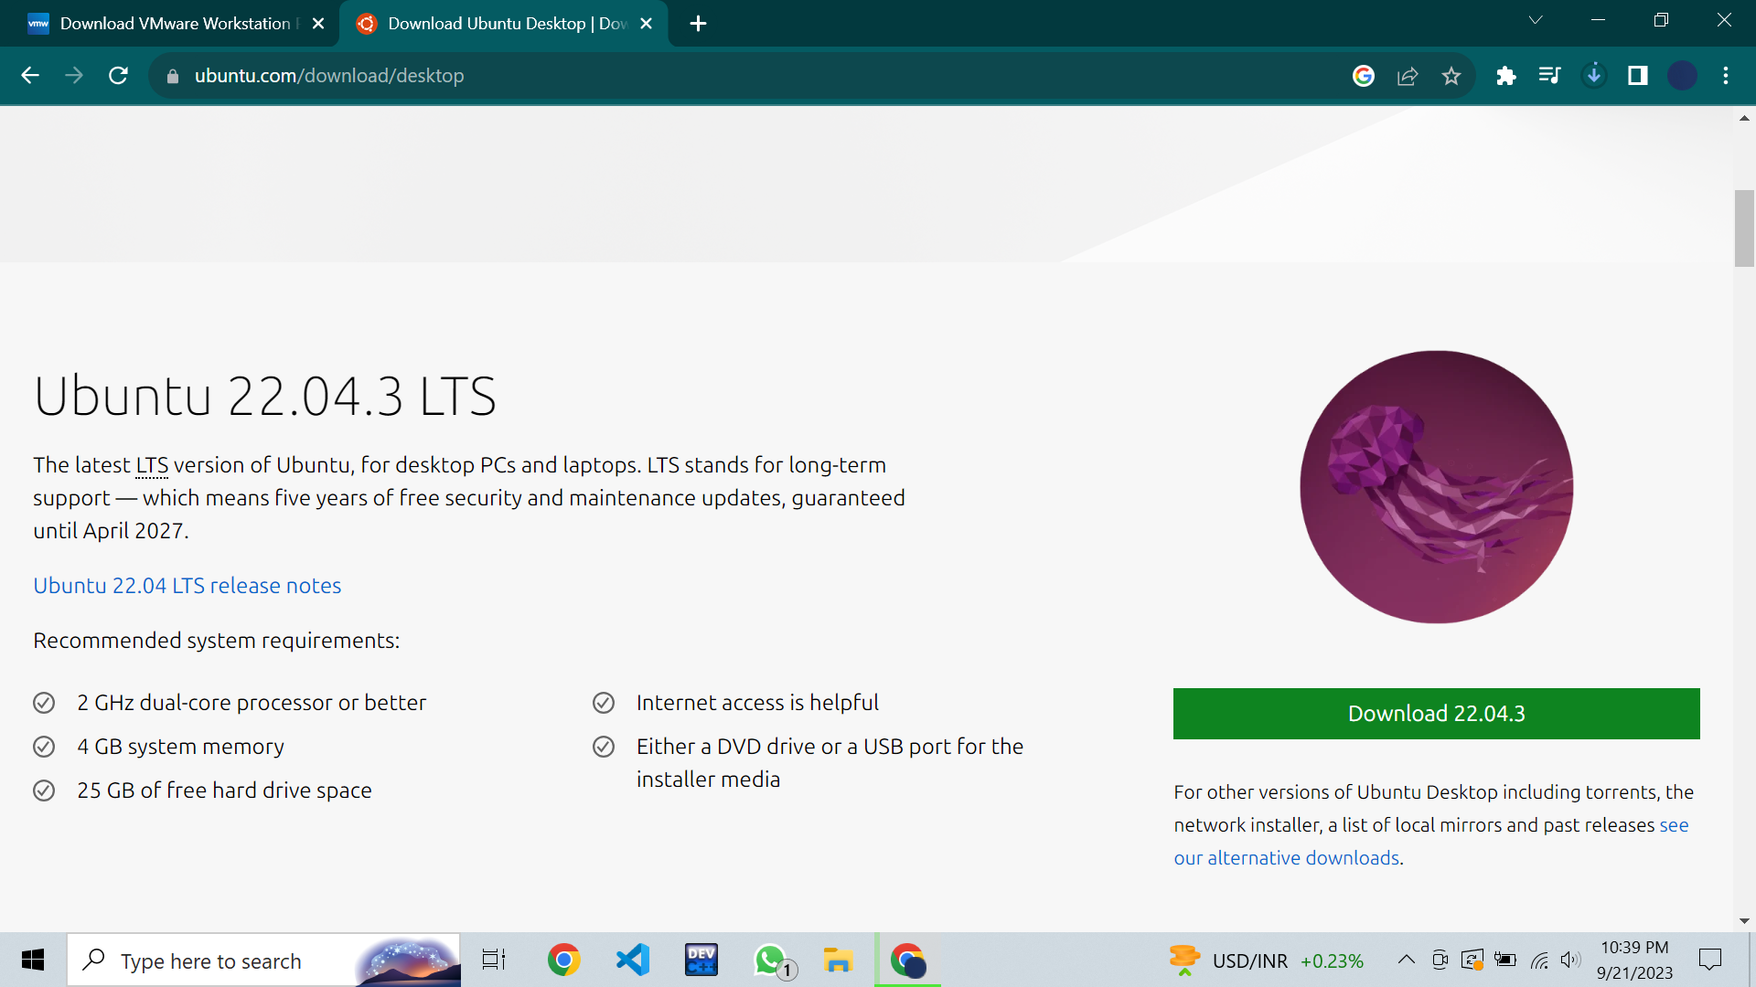
Ubuntu
First of all open google chrome,
Then Search for Ubuntu.
Then download the latest version of Ubuntu.
Click on Download button and its start downloading.

Slide 6
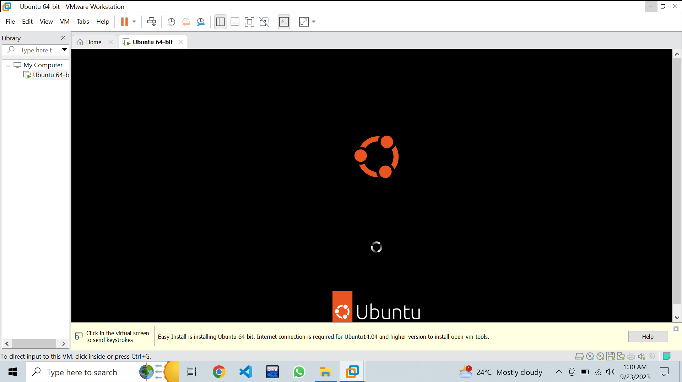
Link Ubuntu and VM

Slide 7
Successfully Setup Virtual Box

